Slide 1
CAT T3 Design
Arun Rajayogan

Slide 2
User Input
Get all 4 vertices
Check if they are invalid (duplicates or simply not making any sense i.e a letter in the coordinate), if invalid keep on asking for correct input until valid
Convert all the vertices to tuples, then add the tuples to a list

Slide 3
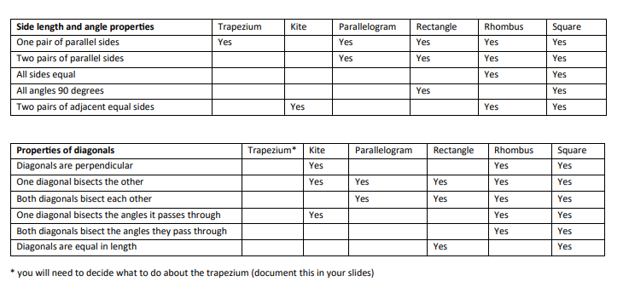
Properties

Slide 4
Properties
Each shape (square, rhombus, rectangle etc.) will have its own set of properties, its own data.
Two sets of data, one for sides and one for the angles.
If the properties of the inputted shape match up, then the match is outputted.
This allows more shapes to be added to the “database(s)” making it very versatile for future use.
A separate function will exist for each property in order to perform multiple simple checks, this makes it more plug and play and so more modular.

Slide 5
Helpful
Most properties in the table are built from previous properties.
Only a small amount of actual math would be done
Helps make everything very modular by approaching it this way

Slide 6
Side Lengths
Use Pythagoras to determine side lengths.
Example:
(2,1) and (1,4)
2-1 = 1 -> a
1 - 4 = -3 -> b
a^2 + b^2 = c^2
1 + 9 = c^2
c = √ 10

Slide 7
Finding Angles
Use law of cosines
Only needs 3 coordinates to work, determine side lengths as outlined in previous slide
Then use formula c = arccos((a2 + b2 - c2)/(2ab))

Slide 8
Vertice Sort
Use first point entered
Finds greatest angle between all other points
4th not included point after finding the angle is furthest vertice from starting point.

Slide 9
The Trapezium
The definition of a trapezium is that it has one pair of parallel sides, a general trapezium has nothing to do with its diagonals, so it won’t be represented in terms of its secondary properties, unless of course we start to include trapezium sub-types, such as the isosceles trapezium.

Slide 10
Parallel and perpendicular lines
Gradients for parallel lines will be the same
Gradients of perpendicular lines multiply to -1
As we are given coordinates, finding the gradient is easy through
m = (y2-y1)/(x2-x1)
(x1, x2) and (y1, y2) were the coordinates

